Slide 1
Dimensionality Reduction

Slide 2
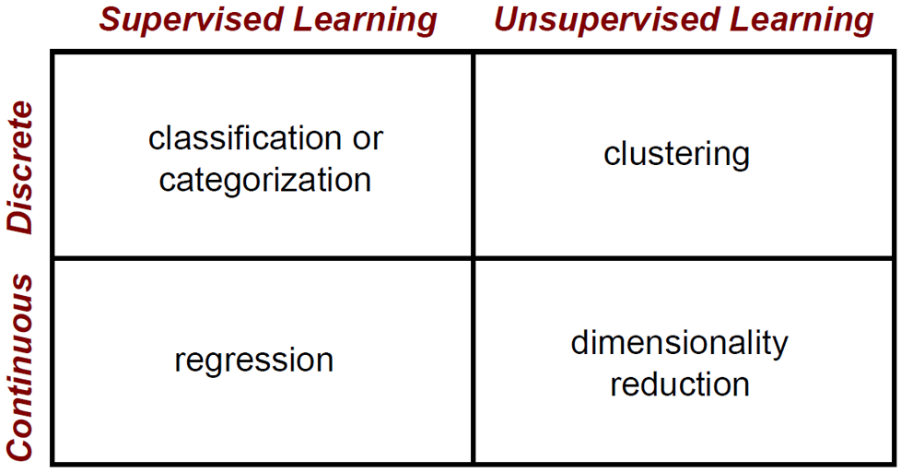
Where are we at?

Slide 3
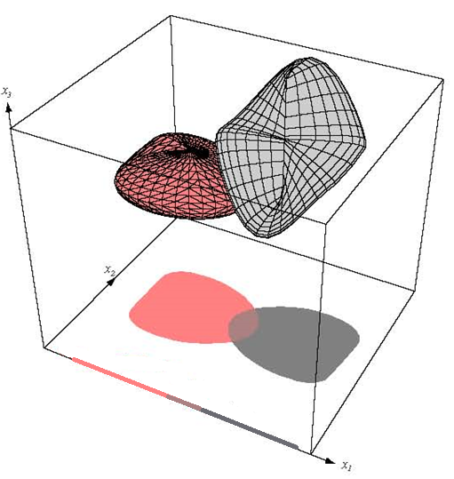
Dimensionality Reduction

Slide 4
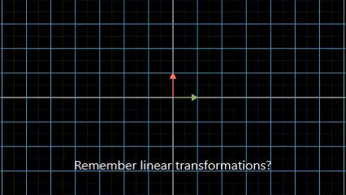
Linear transformations (matrix multiplication) for dimensionality reduction

Slide 5
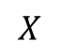
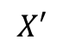
Data Dimensionality
$$X$$
From a naïve point of view, increasing the number of features in X should lead to better classification performance, right?
In practice, the inclusion of more features often leads to worse performance
Due to the curse of dimensionality
Your algorithm enters a high variance (overfitting) zone and needs exponential number of training examples as dimensionality increases
?
$$X′$$

Slide 6
Why dimensionality reduction?
$$X$$
Some data sets contain too many features that make learning unfeasible
Some features may be irrelevant
Some features may be correlated (redundant)
Combinations of observed variables may be more effective bases for insights, even if physical meaning is obscure
It reduces overfitting
Dimensionality reduction can help us to visualize high dimensional data
Dimensionality reduction can also help us to compress the data
Dimensionality reduction
$$X′$$

Slide 7
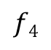
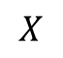
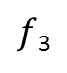
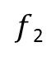
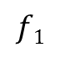
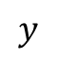
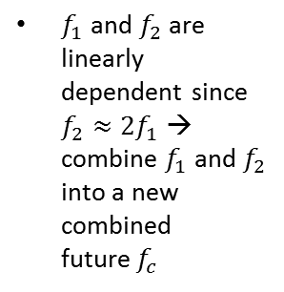
Basic Concept
$$X$$
$$y$$
$$f1$$
$f$₂
$f$₃
$$f4$$
Areas of variance in data are where items can be best discriminated
Areas of greatest “signal” in the data
If two items or dimensions are highly correlated or dependent
They are likely to represent highly related phenomena
Combining them to form a single measure is reasonable
So we want to combine related variables, and focus on uncorrelated or independent ones, especially those along which the observations have high variance
We want a smaller set of variables that explain most of the variance in the original data, in more compact and insightful form
These phenomena are called “factors” or “principal components” or “independent components,” depending on the methods used to determine them
1
2
0
0
a
1
2
0
0
a
2
4
6
0
b
2
4
5
0
b
2
4
1
0
a
1
2
0
0
a
1
2
5
1
b
2
4
4
0
b
$f_{1}$ and $f_{2}$ are linearly dependent since $f_{2}≈{2f}_{1}$ → combine $f_{1}$and $f_{2}$ into a new combined future$f_{c}$

Slide 8
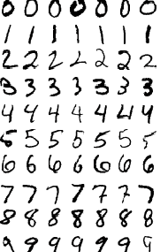
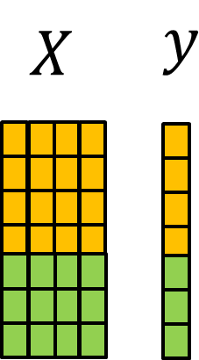

Are very high dimensional data sets truly high dimensional?
In most real-world problems, training instances are not spread out uniformly across all dimensions.
Many features are almost constant, while others are highly correlated.
As a result, all training instances actually lie within (or close to) a much lower-dimensional subspace of the high-dimensional space.
think about the MNIST dataset (a 28x28=784 dimensional data set): all handwritten digit images have some similarities. They are made of connected lines, the borders are white, they are more or less centered, and so on.
If you randomly generated images, only a ridiculously tiny fraction of them would look like handwritten digits. In other words, the degrees of freedom available to you if you try to create a digit image are dramatically lower than the degrees of freedom you would have if you were allowed to generate any image you wanted.
These constraints tend to squeeze the dataset into a lower dimensional manifold.

Slide 9
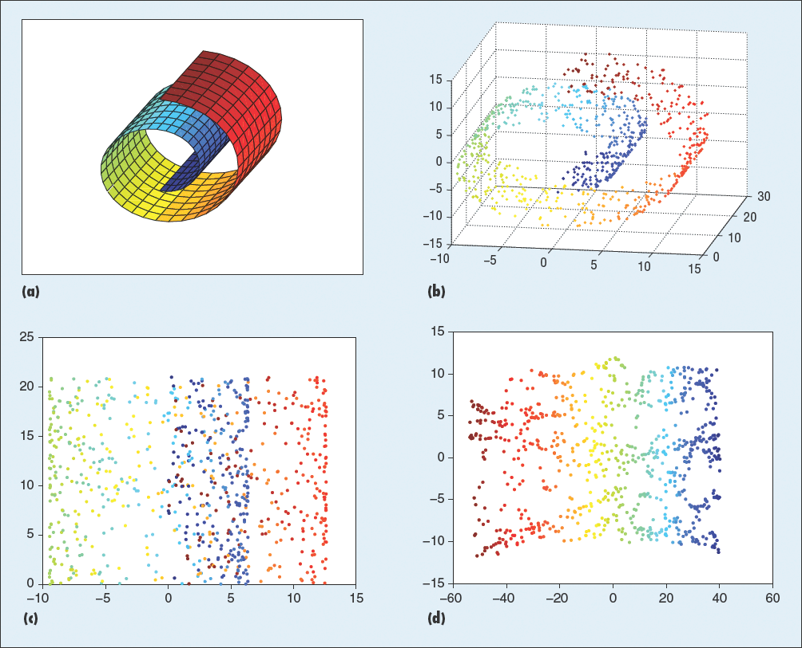
Main Approaches for Dimensionality Reduction
the two main approaches to reducing dimensionality are:
Projection:
Manifold Learning: works by modeling the manifold on which the training instances lie; this is called Manifold Learning. It relies on the manifold assumption, also called the manifold hypothesis, which holds that most real-world high-dimensional datasets lie close to a much lower-dimensional manifold. This assumption is very often empirically observed.

Slide 10
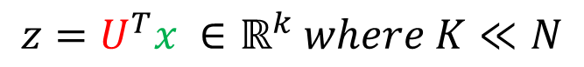
Dimensionality Reduction
Mapping the data into a lower-dimensional space.
$$x1=\left[f1,f2,f3…,f_{N}\right] →z1=\left[b1,b2,…,b_{K}\right] (K≪N)$$
Linear combinations of original features are particularly attractive because they are simple to compute and analytically tractable
Given x ϵ R^{N}, the goal is to find an N x K transformation matrix U such that:
$$z=U^{T}x ∈ℝ^{k} where K≪N$$

Slide 11
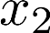
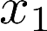
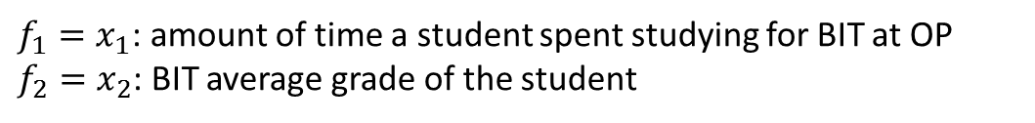
Dimensionality reduction intuition: 2D to 1D
IT expertise
Reduce data from
2D to 1D
Do not confuse with linear regression!
$f_{1}=x_{1}$: amount of time a student spent studying for BIT at OP
$f_{2}=x_{2}$: BIT average grade of the student

Slide 12
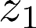
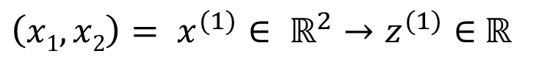
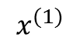
Dimensionality reduction intuition: 2D to 1D
IT expertise
Reduce data from
2D to 1D
${\left(x1,x2\right)= x}^{(1)}∈ ℝ^{2}→z^{(1)}∈$ $ℝ$
$$x^{(1)}$$
x₁: amount of time spent studying in the BIT program
x₂: BIT grades
z₁: IT expertise

Slide 13
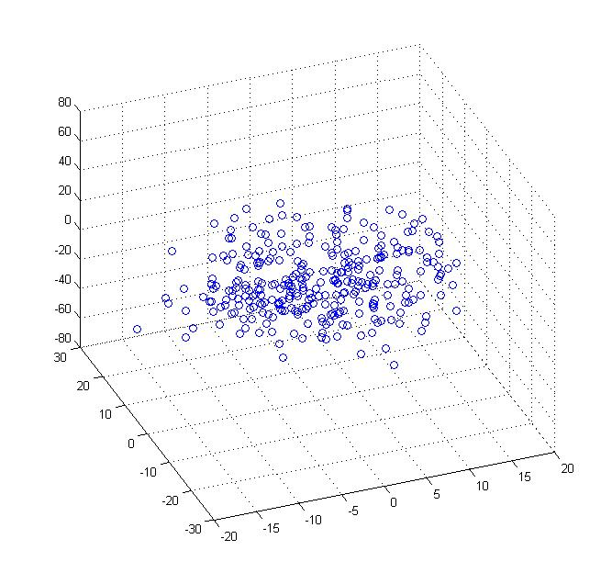
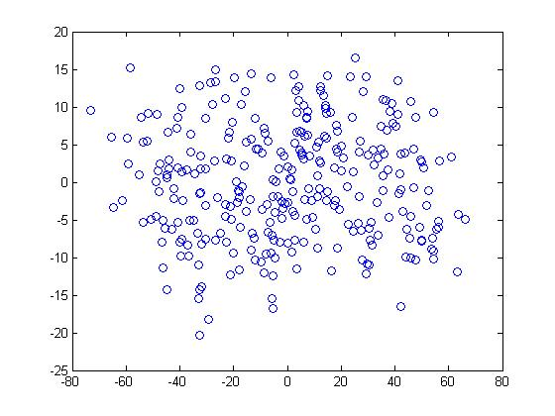
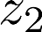
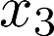
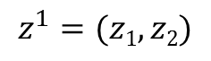
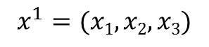
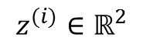
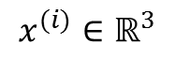
Dimensionality reduction: 3D to 2D
Notice that when doing dimensionality reduction we are compressing the data
$$z^{(i)}∈ℝ^{2}$$
$$x^{(i)}∈ℝ^{3}$$
$$x^{1}=(x1,x2,x3)$$
$$z^{1}=(z1,z2)$$

Slide 14
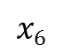
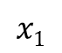
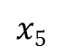
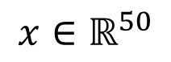
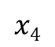
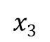
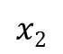
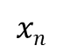
Dimensionality reduction can be useful for Data Visualization
$$x1$$
$$x2$$
$$x3$$
$$x4$$
$$x5$$
$$x6$$
$$xn$$
Country | GDP (trillions of US$) | Per capita GDP (thousands of intl. $) | Human Develop-ment Index | Life expectancy | Poverty Index (Gini as percentage) | Mean household income (thousands of US$) | …
Canada | 1.577 | 39.17 | 0.908 | 80.7 | 32.6 | 67.293 | …
China | 5.878 | 7.54 | 0.687 | 73 | 46.9 | 10.22 | …
India | 1.632 | 3.41 | 0.547 | 64.7 | 36.8 | 0.735 | …
Russia | 1.48 | 19.84 | 0.755 | 65.5 | 39.9 | 0.72 | …
Singapore | 0.223 | 56.69 | 0.866 | 80 | 42.5 | 67.1 | …
USA | 14.527 | 46.86 | 0.91 | 78.3 | 40.8 | 84.3 | …
… | … | … | … | … | … | …
$$x∈ℝ^{50}$$
[resources from en.wikipedia.org]

Slide 15
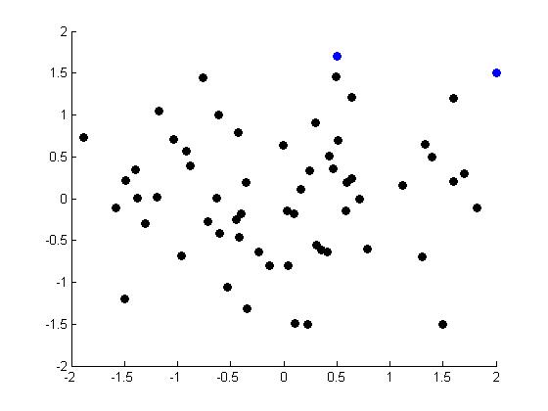
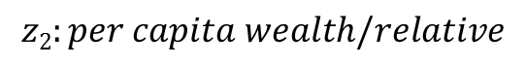
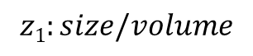
Using dimensionality reduction from 50D to 2D for data visualization
$$z1:size/volume$$
Country
Canada | 1.6 | 1.2
China | 1.7 | 0.3
India | 1.6 | 0.2
Russia | 1.4 | 0.5
Singapore | 0.5 | 1.7
USA | 2 | 1.5
… | … | …
$$z2:per capita wealth/relative$$
Small and rich country
Large and rich country
Large and poor country
Small and poor country

Slide 16
Dimensionality Reduction with Principal Component Analysis (PCA)

Slide 17
Principal Component Analysis
Most common algorithm for dimensionality reduction
The new variables/dimensions
Are linear combinations of the original ones
Are uncorrelated with one another
Orthogonal/Perpendicular in original dimension space
Capture as much of the original variance in the data as possible
Are called Principal Components

Slide 18
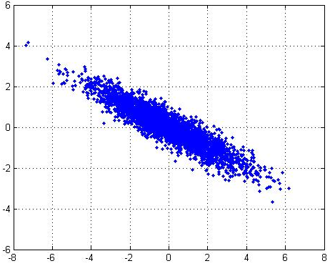
2D dataset

Slide 19
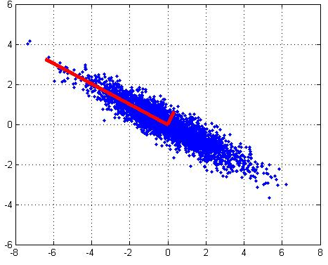
PCA components
1st PCA axis
PCA projects the data along the directions where the data varies the most
Directions are Orthogonal
2nd PCA axis
1st principal component axis is the direction of greatest variability in the data
2nd principal component axis is the next orthogonal (uncorrelated) direction of greatest variability
(perhaps noise)

Slide 20
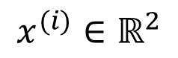
Principal Component Analysis (PCA) problem formulation
$$x^{(i)}∈ℝ^{2}$$
The green line is a good new axis for the data that stills maintains most of the variability of the data while minimizing the square distance from the data points to the new dimension

Slide 21
Principal Component Analysis (PCA) problem formulation
$$x^{(i)}∈ℝ^{2}$$
The green line is NOT a good new axis for the data since it doesn’t maintain most of the variability of the data and the distance from the data points to the new dimension is large

Slide 22
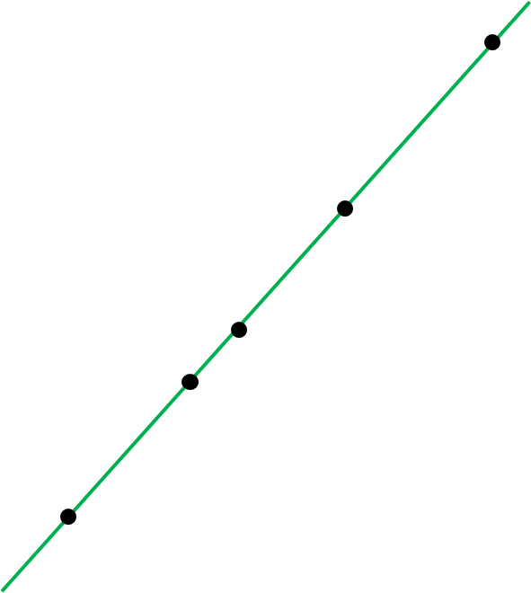
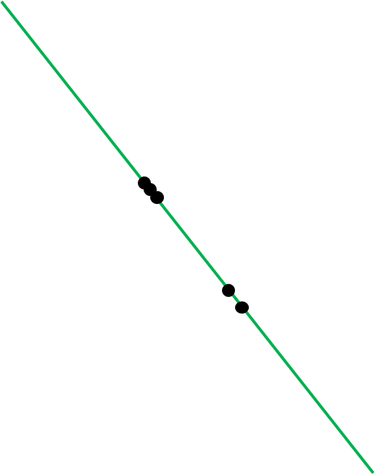
PCA projects the data into the axis that contains most of the variance in the data
It is reasonable to choose the axes that preserves the maximum amount of variance, as it will more likely lose less information than the other projections

Slide 23
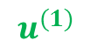
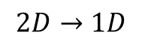
Principal Component Analysis (PCA) problem formulation
$$2D→1D$$
$$u^{(1)}$$
Reduce from 2-dimension to 1-dimension: Find a direction (a vector $u^{(1)}$ )
onto which to project the data so as to minimize the projection error.

Slide 24

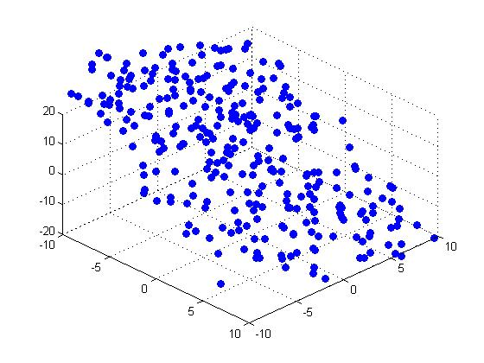
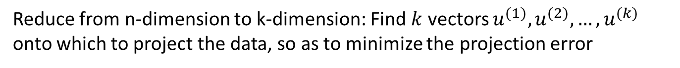



Principal Component Analysis (PCA) problem formulation
$$3D→2D$$
$$u^{(2)}$$
$$u^{(1)}$$
Reduce from n-dimension to k-dimension: Find $k$ vectors $u^{(1)},u^{(2)},…,u^{(k)}$
onto which to project the data, so as to minimize the projection error

Slide 25
Principal Component Analysis (PCA) IS NOT linear regression
Principal Component Analysis
Linear regression

Slide 26





Reconstruction from compressed representation
$$z=U_{reduce}∙x$$
$$x≈\hat{x}=U_{reduce}∙z$$

Slide 27


Choosing (number of principal components)
PCA identifies the axis that accounts for the largest amount of variance in the data set.
next it finds a second axis, orthogonal to the first one, that accounts for the largest amount of remaining variance.
It then finds a third axis, orthogonal to both previous axes, and a fourth, a fifth, and so on—as many axes as the number of dimensions in the dataset

Slide 28

Applications of PCA
Improve classification
PCA Reduces the impact of the curse of dimensionality
Compression
Reduce memory/disk needed to store data
Speed up learning algorithm
Visualization of the data in 3D, 2D or 1D ($k≤3)$
Understanding the relationship between predictors X and output variable y

Slide 29





How to carry out PCA: Singular value decomposition (SVD)
So how can you find the principal components of a training set?
Luckily, there is a standard matrix factorization technique called Singular Value Decomposition (SVD) that can decompose the training set matrix $X$ into the dot/matrix product of three matrices $X=U∙Σ∙V^{T}$
where $V^{T}$ contains all the principal components that we are looking for
Singular value decomposition is essentially trying to reduce a rank R matrix to a rank K matrix (K<<R).
It means that we can take a list of R unique vectors, and approximate them as a linear combination of K unique vectors.
Once you have identified all the principal components, you can reduce the dimensionality of the dataset down to R dimensions by projecting it onto the hyperplane defined by the first R principal components.
Selecting this hyperplane ensures that the projection will preserve as much variance as possible.
To project the training set onto the hyperplane, you can simply compute the dot/matrix product of the training set matrix $X$ by the matrix $W_{d}$, defined as the matrix containing the first R principal components (i.e., the matrix composed of the first R columns of $V^{T}$.
$X_{R−projection}=X∙W_{d}$
$$X=UΣV^{T}$$
$$X$$
SVD
$u$₁
$$u2$$
$u$₃
First 3 principal components

Slide 30











Singular value decomposition (SVD)
$$X=UΣV^{T}$$
400 unique row vectors
K=1
K=2
K=10
K=50
$$r_{i}=x_{i}$$
$$r_{i}=c_{i}v_{1}$$
$$r_{i}=c_{i}v_{1}+b_{i}v_{2}$$
$$r_{i}=c_{i}v_{1}+{…+b}_{i}v_{10}$$
$$r_{i}=c_{i}v_{1}+{…+b}_{i}v_{50}$$

Slide 31






Principle Components/Eigenvectors for facial recognition and reconstruction
Want to identify specific person, based on facial image
Classification Algorithms not working with all of the 256 x 256 images (probably due to not having enough data, i.e. curse of dimensionality)
Reconstructing a high dimensional representation using the principal components
$$U_{reduce}=$$
$$x$$
$$\hat{x}=U_{reduce}∙z$$

Slide 32




Data set consisting of the number of arrests per 100,000 residents for each of 3 crimes: assault, murder and rape. The percentage of the population in each state living in urban areas was also recorded.
Murder
Assault
Rape
Population
$$X=\left[\begin{aligned}\begin{matrix} & & \begin{matrix} & \end{matrix}\end{matrix} \\ \begin{matrix} & & \begin{matrix} & \end{matrix}\end{matrix} \\ … \\ \begin{matrix} & & \begin{matrix} & \end{matrix}\end{matrix}\end{aligned}\right]$$
State 1
State 2
State n
PC2
PC1
$$X′=\left[\begin{aligned}\begin{matrix} & \\ & \end{matrix} \\ … \\ \begin{matrix} & \end{matrix}\end{aligned}\right]$$
State 1
State 2
State n

Slide 33


The principal components of political opinion

Slide 34



Genetic Map of Europe
$$X→$$
Micro Array SNP expression data

Slide 35
PCA summary
PCA analysis permits us to reduce the dimensionality of a data set 𝑋 into a smaller feature matrix 𝑋′
PCA allows the discovery of latent features driving the patterns in data
number of rooms in the house, number of windows in the house→ Size of the house
This reduction in dimensionality offers opportunities to
Visualize high dimensional data
Identify the strongest patterns in the data
Reduce noise
Capture most of the variability of the data by a small fraction of the total set of dimensions
Make other algorithms (regression, logistic regression,…) work better by using fewer input features

